Slide 1

Web Design
Planning & Storyboarding

Slide 2
Design Process
Information gathering
Information architecture
Visual design

Slide 3
Define the scope (functionally & content)
Business goals – what is the purpose (business needs)
User Requirements – to meet users needs
Usability Requirements
Target Audience – influences content, colours, tone of voice
Create 3 user stories for your target audience & their requirements.
Pre-production plan maybe submitted for approval and can be referred to during production to clarify things.

Slide 4
Requirements Gathering - Questions
What is the target market?
What devices are they using?
How many pages are needed?
What is the brand and colours?
Resources: Requirement Gathering Questions
Client Interview example
More on Scope

Slide 5
Style Guide
Identify CSS for the main elements
Logos
Fonts
Photos
Colours
See Sample Style Guide from Elementor

Slide 6
2. Information Architecture (Site Map)
How the website pages are related or connected
The Home Page is a special case, usually represented as a parent of the other pages.
Primary navigation on almost every page, usually across the top
If a page is divided into sections it could have a secondary menu, usually is on the left-hand side, or under a header image. For example https://visitkilkenny.ie/ or https://www.irishtimes.com/
Deeper levels, for example with e-commerce websites may use sub-list menus, which can become quiet complicated.

Slide 7
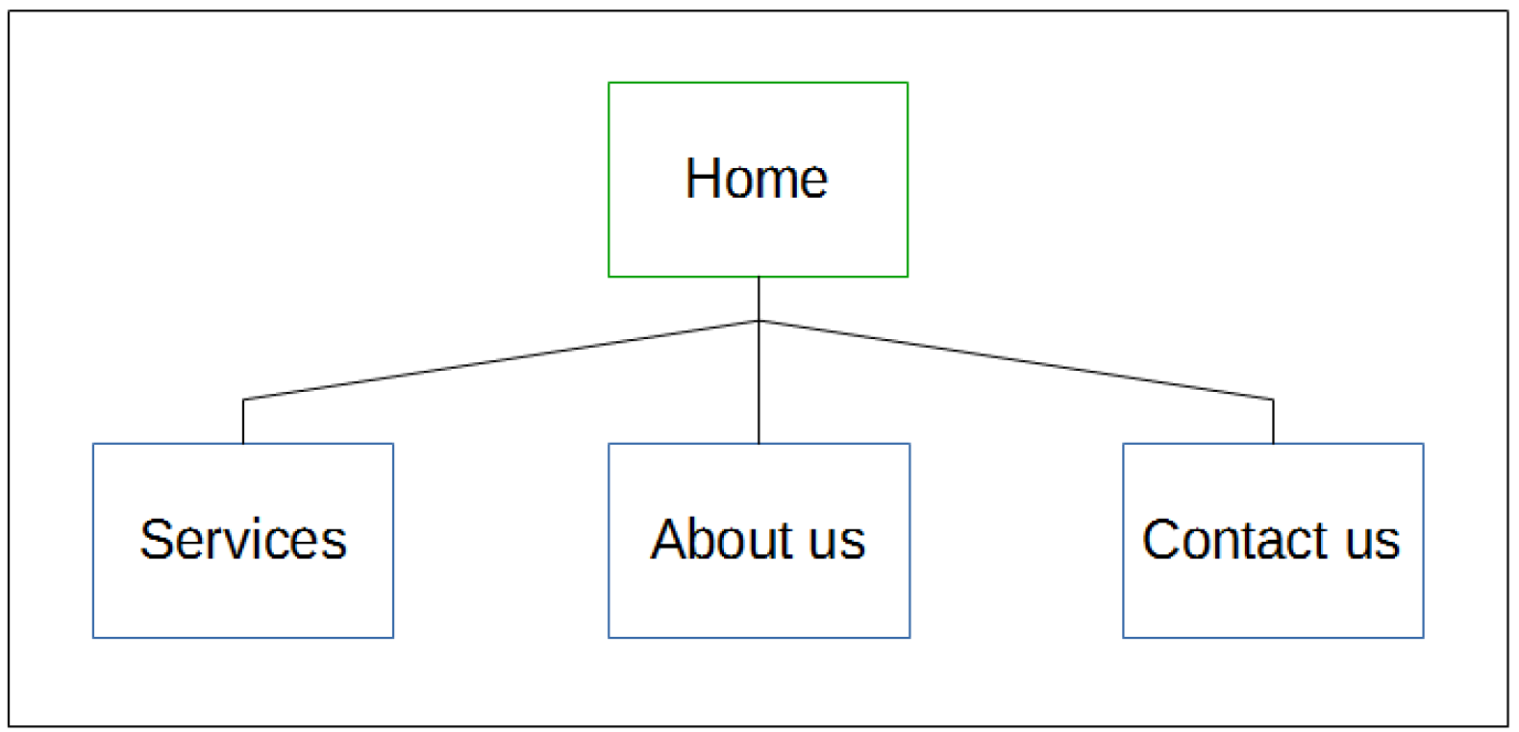
Balloons Website - Sitemap

Slide 8
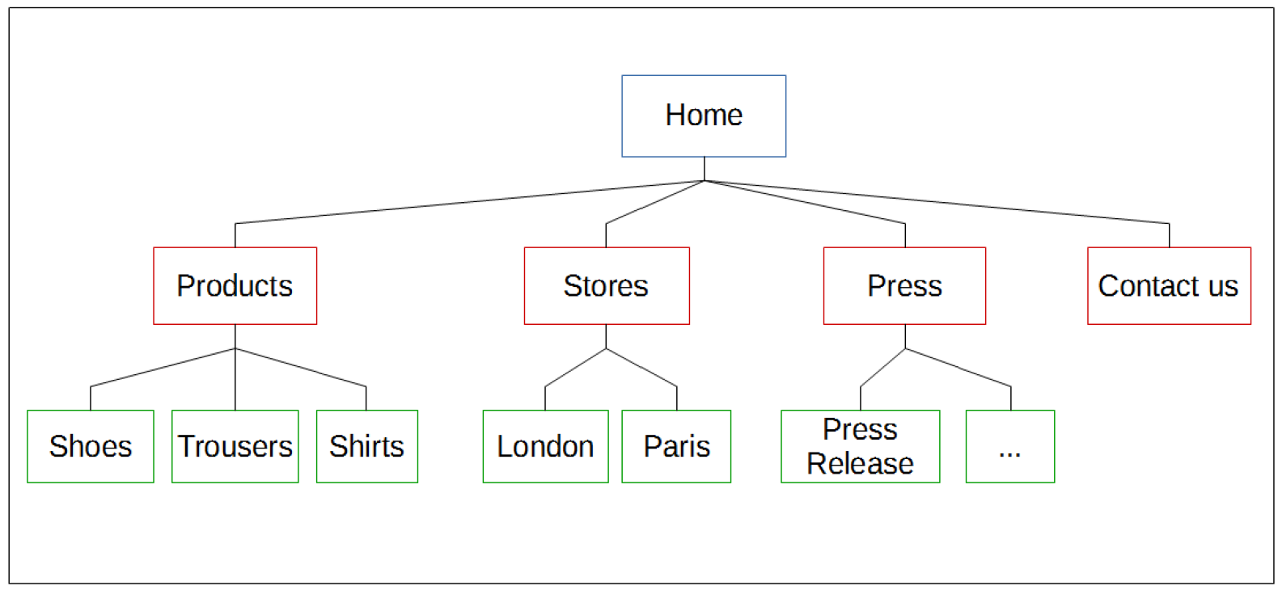
A more complex site
Top Level
Second Level
Notes:
… more press releases

Slide 9
Supplemental Menus
Supplemental pages may not be directly related to the main content
terms and conditions
privacy policy
copyright info
register/log in/out
Additional menus are created for these, grouped into categories, and displayed at the top or bottom of a page.
They maybe styled differently but all menus use the <ul> and <li> elements.

Slide 10
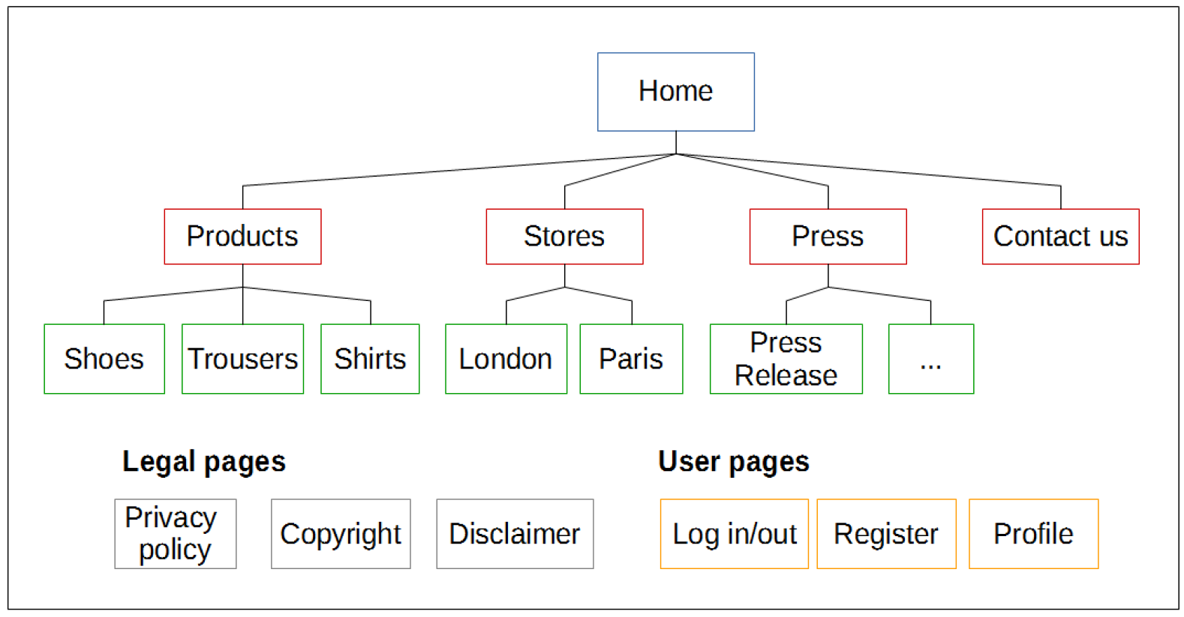
Two Supplemental Menus

Slide 11
Diagrams
The quickest way is to use pen and paper
If you need to work with a team, a digital version is easier to share.
Word/PowerPoint, Excel – Use Shapes
Many online tools (search online site structure diagram)
See MDN Document and Website Structure

Slide 12
3. Visual Design - Principles
Focus on grouping, prioritising and positioning the elements so that the interface is usable and intuitive.
1. Visual Hierarchy
2. Divine Proportions
3. Hick’s Law - choices
4. Fitt’s Law – distance vs time.
5. Rule of Thirds
6. Gestalt Design Laws and Principles - Perception
7. White space and clean design
8. Occam’s Razor
cxl.com/blog/universal-web-design-principles/#h-4-fitt-s-law
2023 Top Trends
Simplicity
Mobile-first
Accessibility
User experience
Personalization
More - 17+ Web Design Principles Every Develop Must Follow in 2023

Slide 13
Design the layout
Identify the components/elements that will be used on the pages.
Global elements – that will appear on all pages, for example the primary navigation
Other elements on specific pages, for example a form on the contact page.
Create a wireframe for each page
Online tools: mockflow, figma, balsamiq, lucidchart, miro, justininmind.

Slide 14
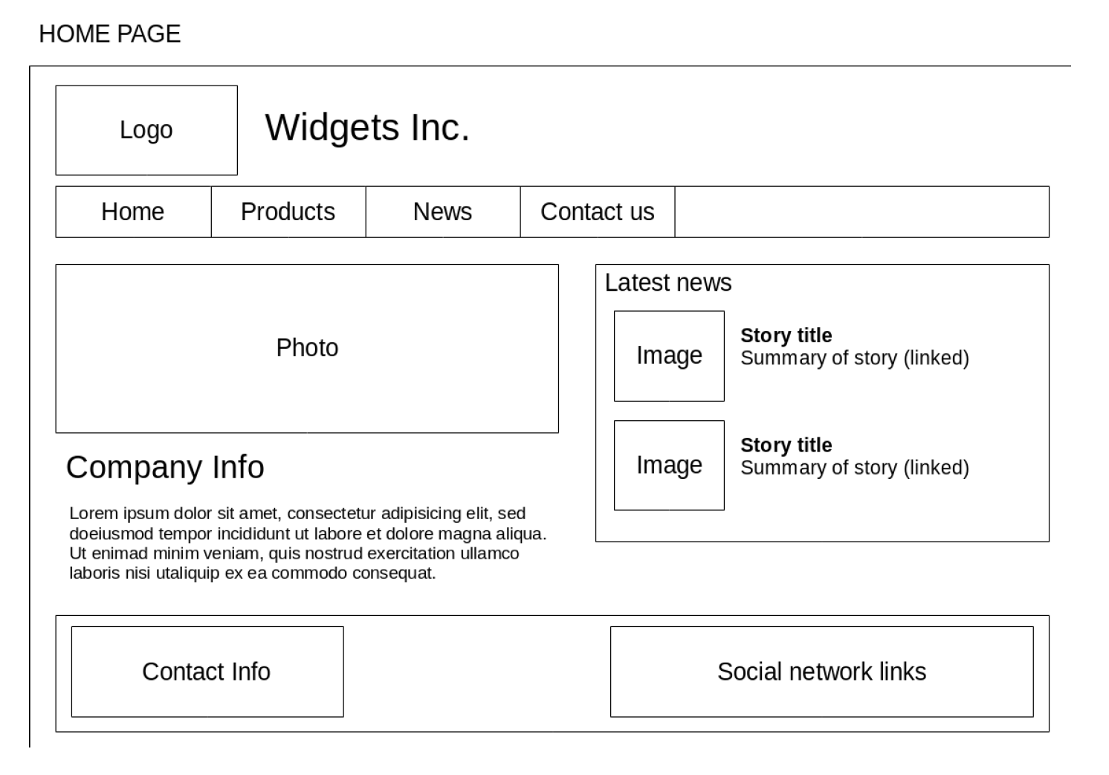
Wireframe

Slide 15
Composing Wireframes
Consider the visibility of important elements
Maintain consistency between the pages
Consider conventions that exist for certain elements (logos, navigation menus)
Keep in mind what is possible with HTML and CSS
Ensure it is obvious what each element on the wireframe is
Annotate the diagrams with style guidelines/ideas

Slide 16
Real World Wireframes
Have no style information included!
A selection of mock ups would be created by the graphic designer, based on the wireframes.
For our purposes,
We will include some guidelines/ideas about the styles and font (or fonts) and colours we plan to use, etc.

Slide 17

Colour

Slide 18
Colour
The choice of colours used on a website is very important:
the colours we use should convey the right mood
the colours should fit with the organisation’s image
Colours also influence the visibility of important elements and readability of the site content

Slide 19
Main colour
Start with a single base colour normally defined by the organisation (i.e. used in their logo)
Then devise a harmonious palette, based upon the base colour
Either manually, or with colour theory
Monochromatic and analogous schemes = subtle, conservative, uniform
Complementary and triadic schemes = bold, brash, eye-catching

Slide 20
Colour Schemes
Monochromatic: tonal variations of the base colour
Analogous: the base colour + its adjacent colours from the wheel
Complementary: the base colour + colour on the opposite side of the wheel
Triadic: the base colour + 2 other colours, all colours evenly spaced around the wheel circumference
Several online tools: Adobe Colour, W3schools color picker, Coolor.co Palette generator

Slide 21
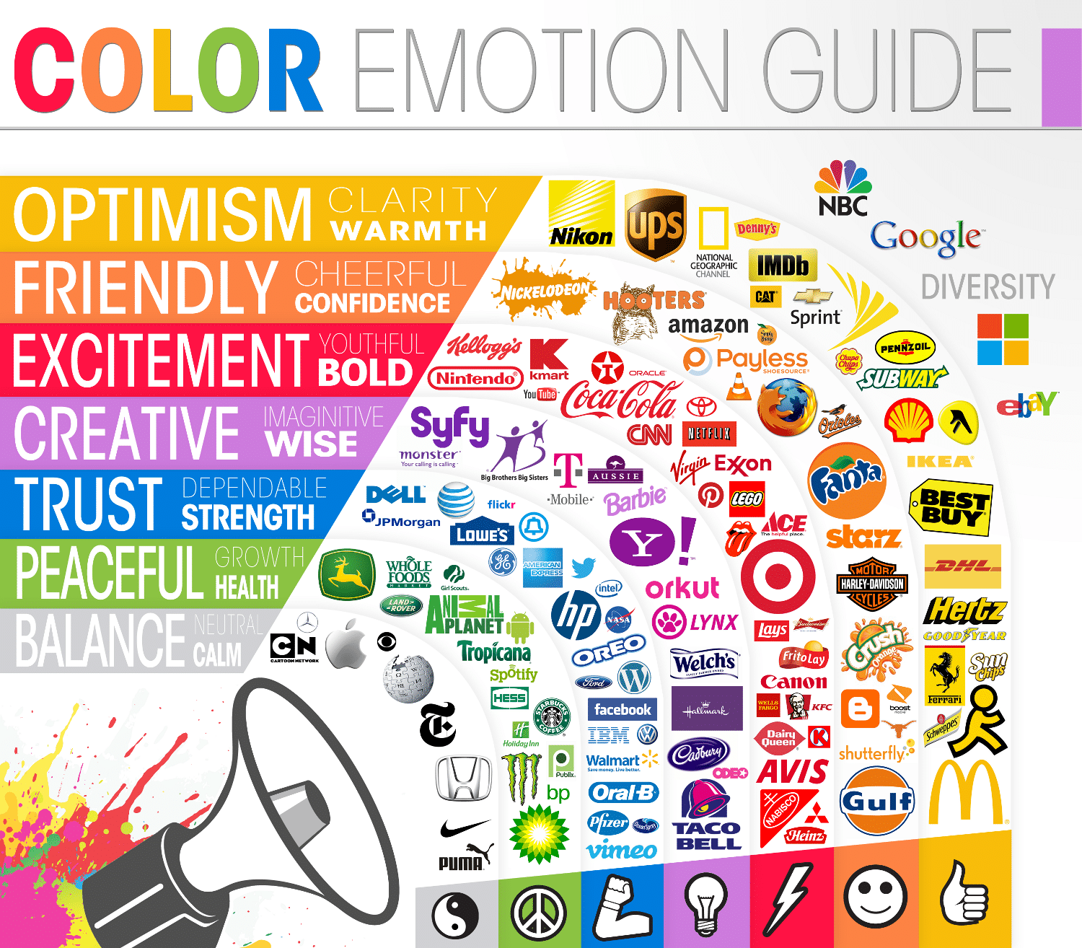
Colour emotion

Slide 22
Practice: Task 1
Name three colours you would like to use?
What colours would you not like to use?
See Website Review Exercise
Choose a tool and create a wireframe for the Balloons website

Slide 23
POUR (Perceivable, Operable, Understandable, Robust)
Web Accessibility Directive (EU 2016/2102) has been in force since December 2016
Better access to websites and mobile apps of public services for everyone!
Transposed into Irish law in September 2020.
Public bodies must ensure their websites and mobile apps conform.
W3C WCAG
Customer Communications Toolkit

Slide 24
Website Evaluation
There are a number of tools that can be used to check the accessibility of a website :
W3 Link Checker
Tingtun Checker(check PDFs online)
WAVE Web Accessibility Evaluation Tool
W3C Web Accessibility Evaluation Tools List
w3schools.com/accessibility/accessibility_landmarks.php

Slide 25
Contrast/Colour Checkers
Coblis, Online Colour Blindness Simulator
Colorable, Online Colour Contrast Tool
Tanaguru, Online Colour Contrast Finder
Paciello, Desktop Colour Contrast Analyser
Also see the contrast ration section in Chrome developer tools

Slide 26
Practice: Task 2
Identify three sites that you like, why?
Identify three sites that you don’t like, why?
Any other observations based on what you have learnt?
Ease of use
Navigation
Colours
Readability
Features, and so on.

Slide 27
Assessment Task A: terminology inclusions
Scope
User Stories
Principles
UI
SEO – 3 approaches.

